Slide 1
Southern California Hospitality and Service Employment Markets
Chick-fil-A Rancho Cucamonga
External Factors and Labor Research

Slide 2
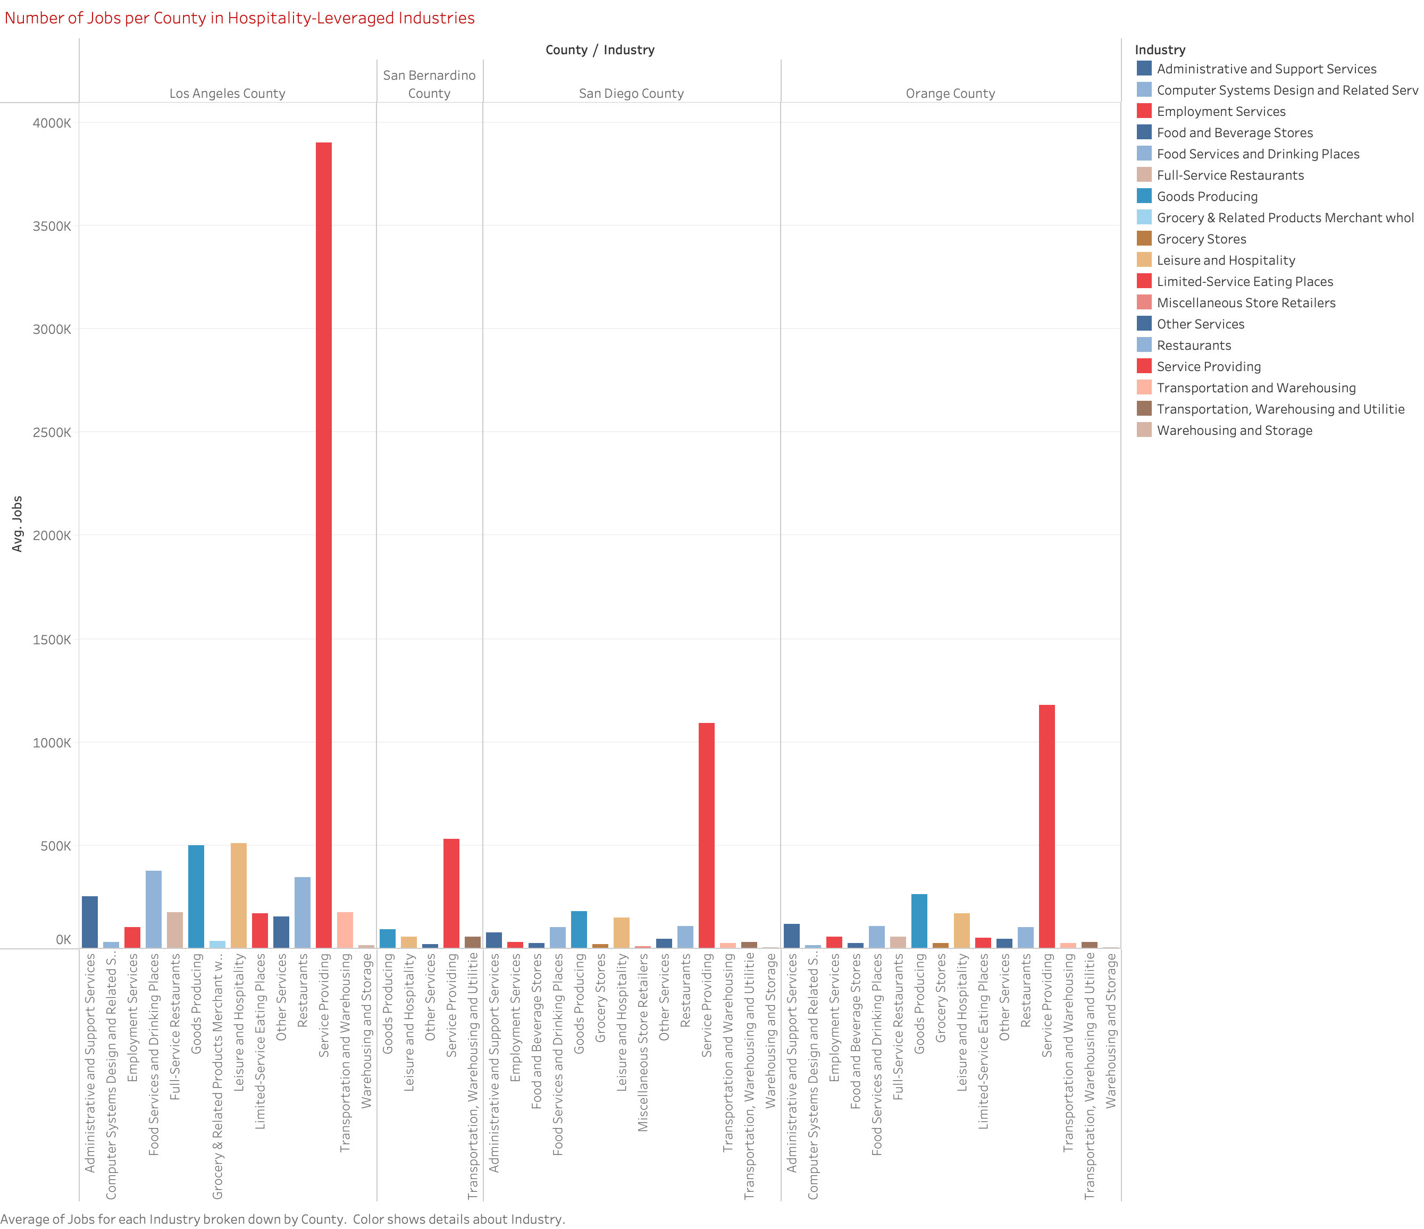

Slide 3
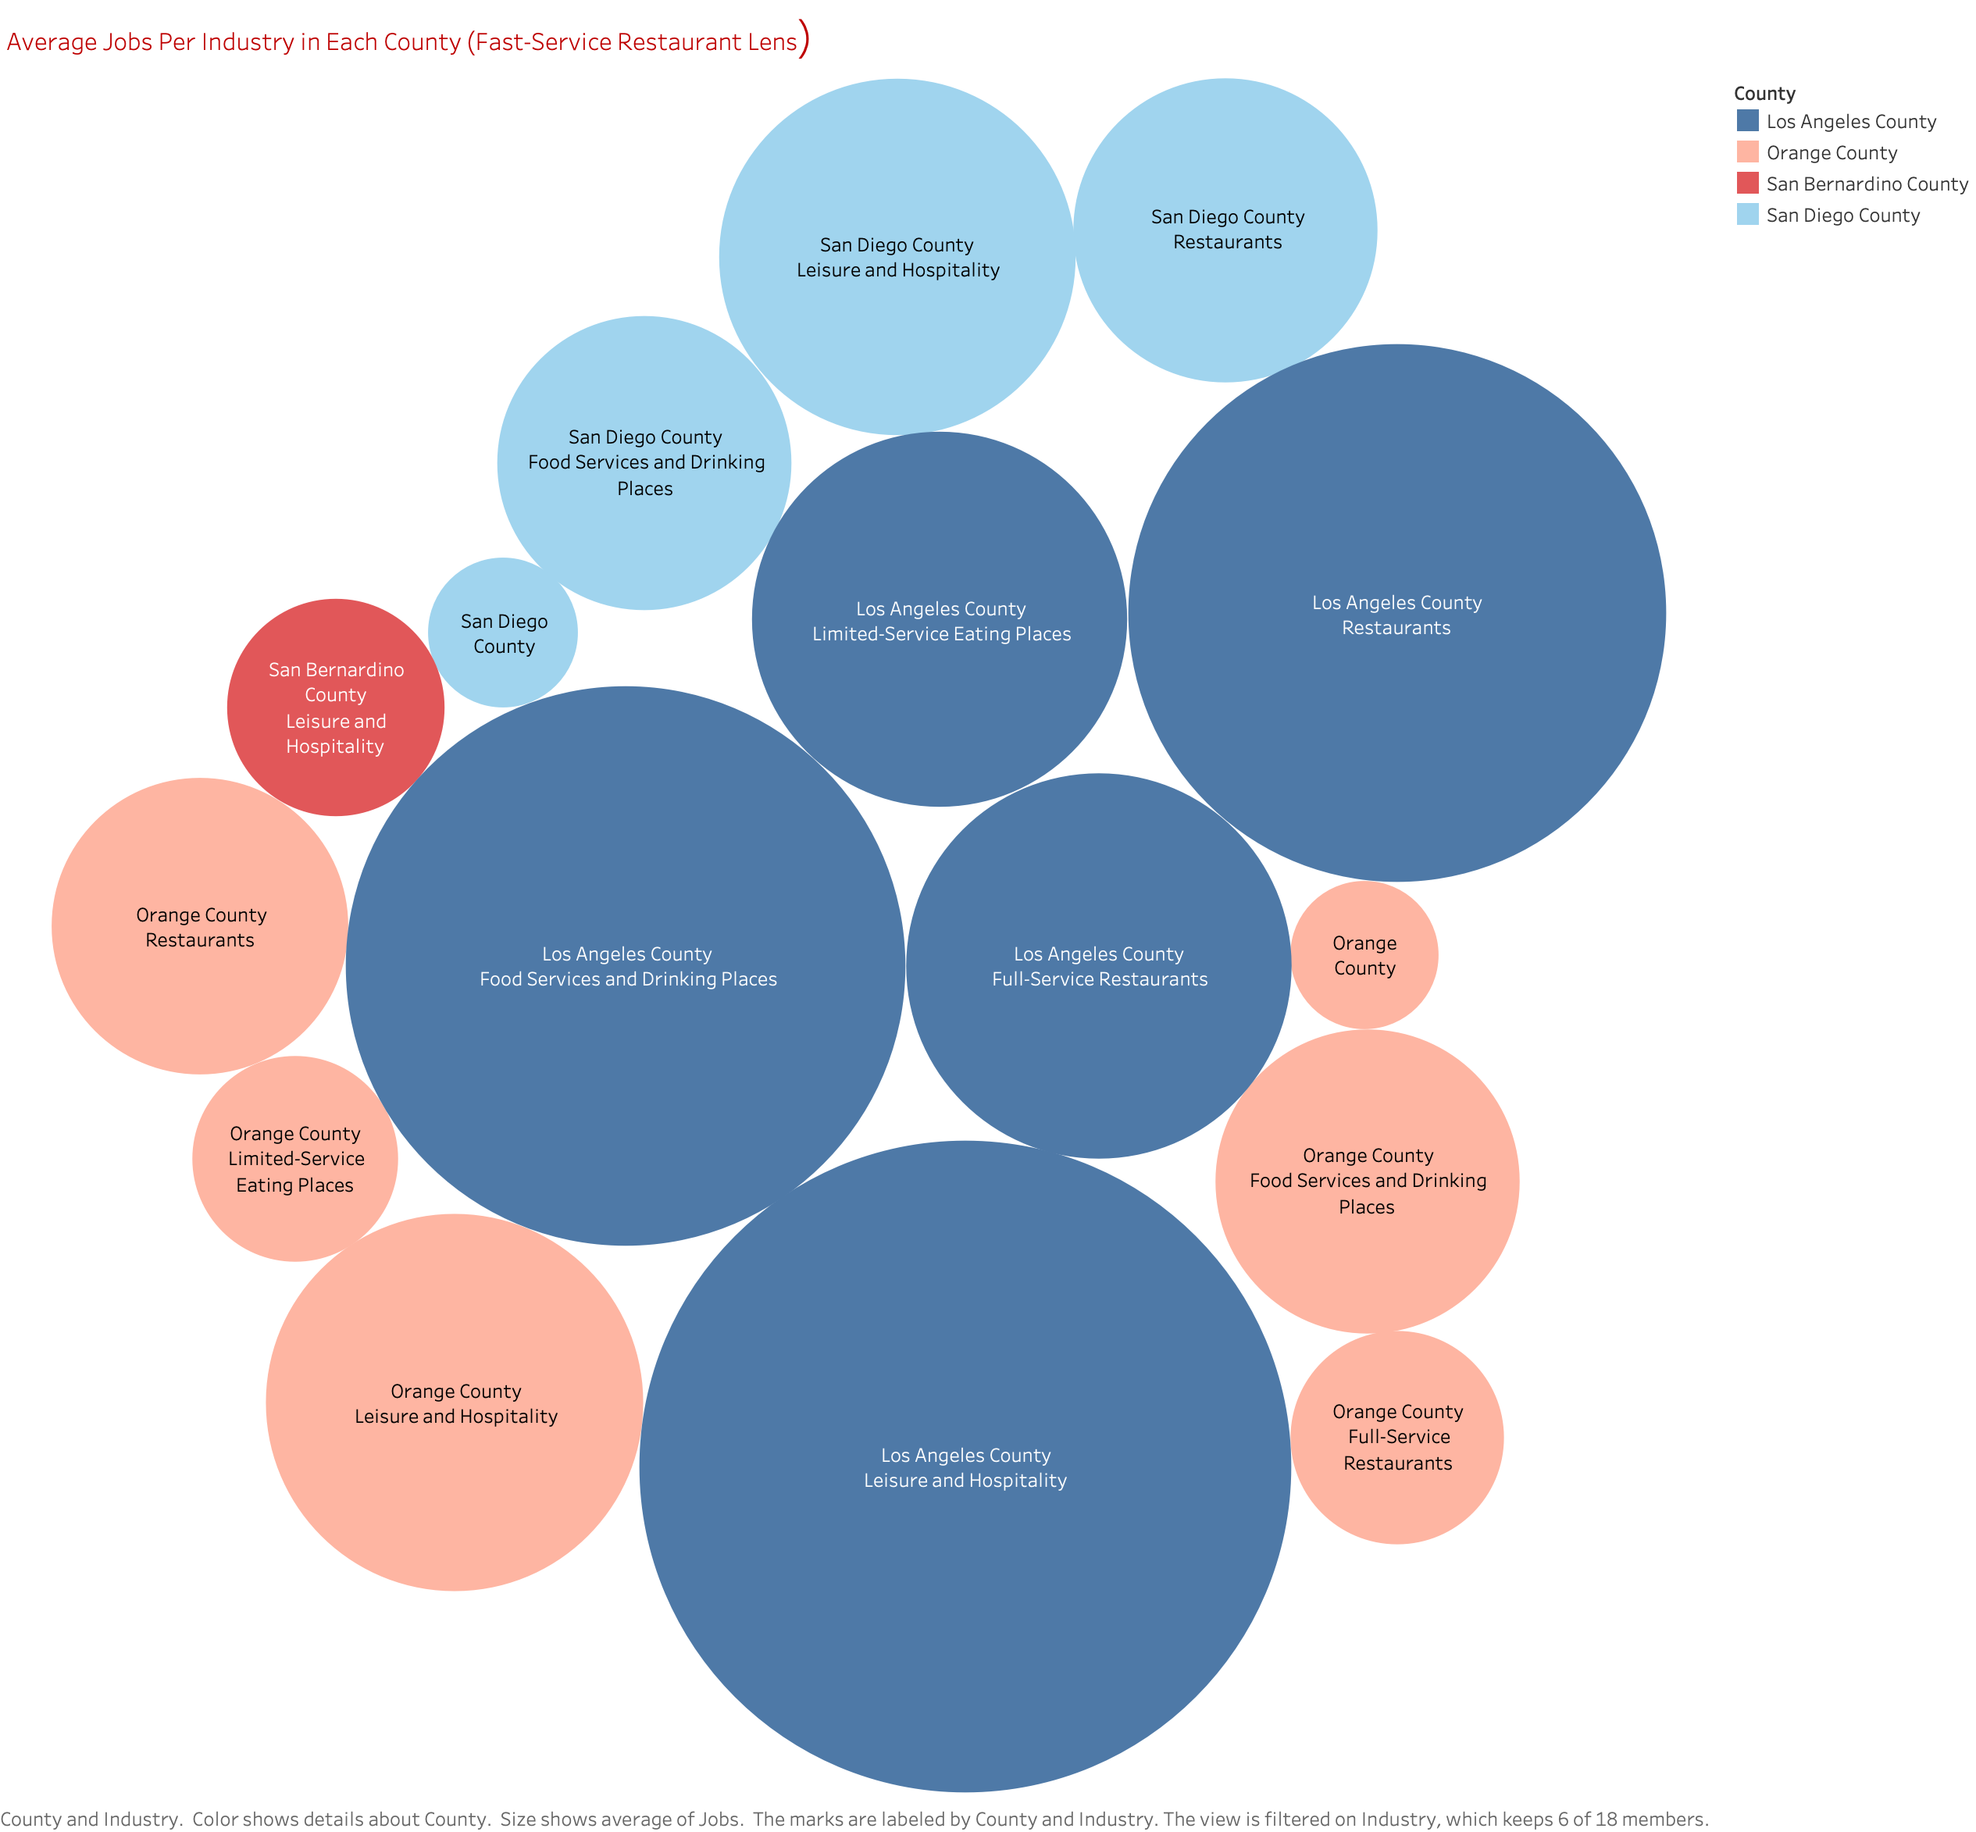

Slide 4
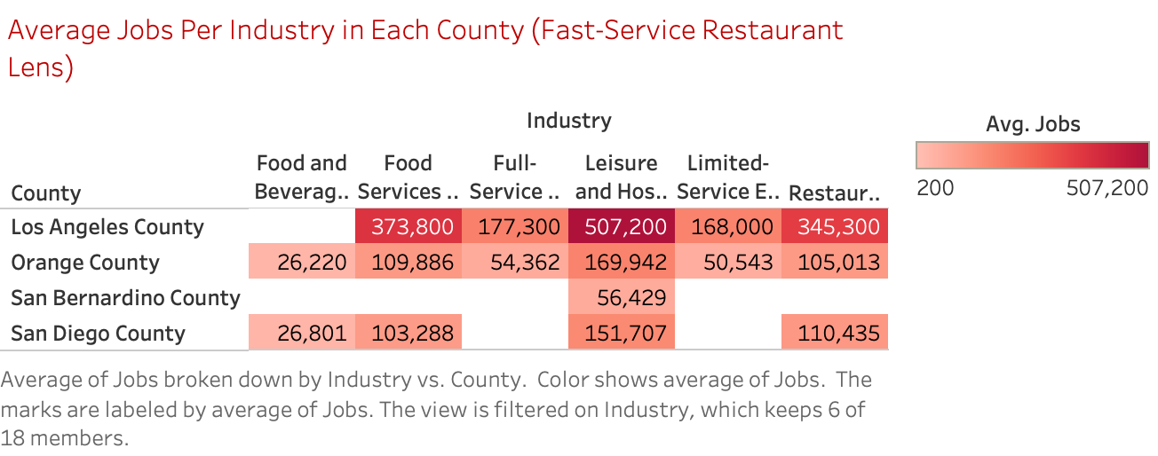

Slide 5
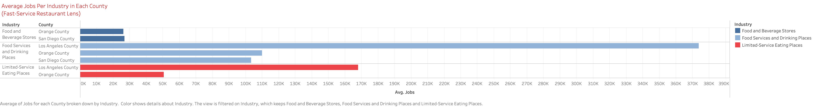

Slide 6
